Slide 1
Row-level security (RLS)
Power BI

Slide 2
Row-Level Security
Row-level security (RLS) is used to restrict data access for given users. Filters restrict data access at the row level, and you can define filters within roles.
RLS is important because it is a key component of any organization’s data security strategy.
By implementing RLS, your organization can ensure each Power BI report user has the appropriate data visibility.
Without RLS, end users could have visibility into data that they shouldn’t have access to (e.g., payroll or sales data), causing unforeseen issues for your organization.

Slide 3
Row-Level Security
Here are some Row-Level Security Use Cases!
Below are examples of RLS use cases seen across many organizations:
Location Based RLS
I want a user only to see information within a specific location (City/State/Region/Country)
(Example: I am the Head of Finance for the west region and should only see data for that specific area)

Slide 4
Row-Level Security
Business Line Based RLS
I want a user to only see information within a specific business line (Product/Service/Department/Division/Unit)
(Example: I am a Buyer for men’s clothing and should only see data for my specific division)
Job Title Based RLS
I want a user only to see information for which their job title is responsible
(Example: I am a Store Manager and should only see data that other store managers see)

Slide 5
Row-Level Security
Employee Based RLS
I want a user only to see information they are tied to or responsible for (Email/Name)
(Example: I am a Business Development Representative and should only see data for my CRM pipeline opportunities)

Slide 6
Types of Row-Level Security
Static Row Level Security & Dynamic Row Level Security
Static Row Level Security:
Its easy to apply and requires a Power BI Developer to define the security logic within a PBIX file. Static Power BI RLS is easy to set up and implement and requires minimal IT involvement. However, it requires high maintenance, and manual implementation, and is not reusable.

Slide 7
Types of Row-Level Security
Dynamic Row Level Security
Its a bit more complicated and requires the security logic to be defined within the PBIX file on the data model side using relationships. Setting up Dynamic Power BI RLS is time-consuming and requires dimension tables (users table/roles table). Hence, it requires a greater IT involvement with minimal maintenance. Dynamic RLS is an automated and reusable security model.

Slide 8
Static Row-Level Security
Static RLS Use Cases
You can use Static RLS when data visibility needs to be limited for a specific group of users that need access to the same level of information.
Static RLS is best suited for Power BI reports with less number of users and security roles.
Use Static RLS when your Power BI report has a high level and straightforward security logic (for example, when the security logic is defined by the user, region, or company).
As the name suggests, Static RLS is used when the user security requirements stay stagnant (or static). For example, consider a case where security groups and security group users are not changing frequently.
Similar to the last case, implement Static RLS when the users are not added or removed frequently.

Slide 9
Dynamic Row-Level Security
You can use Dynamic RLS when data visibility needs to be limited for a specific group of users that need access to different levels of information.
Dynamic RLS is best suited for Power BI reports with a greater number of users and security roles.
Use Dynamic RLS when your Power BI report implements a complicated and complex security logic (for example, when the security logic is defined by job function, department, locality, or combination).
As the name suggests, Dynamic RLS is used when the user security requirements are frequently changing (or are dynamic). For example, consider a case where security groups and security group users are changing frequently.
Similar to the last case, implement Dynamic RLS when the users are added or removed frequently.

Slide 10
Limitation of Power BI Row-Level Security
list of the limitations of Power BI Row Level Security.
Previously defined roles and rules in the Power BI service must be recreated in Power BI Desktop.
You can apply Row Level Security only on the data models created with Power BI Desktop. You must convert the other format files into Power BI Desktop (PBIX) files to implement Power BI RLS.
Power BI Row Level Security only supports ETL and DirectQuery connections. Live connections to Analysis Services are supported in the on-premises model.

Slide 12
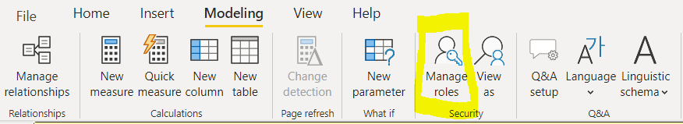
Defining Roles and Rules in Power BI Desktop
On the ‘Modeling’ tab in the Power BI toolbar click on “Manage roles”.
Dataset use example : RLS Sample Data.xlsx

Slide 13
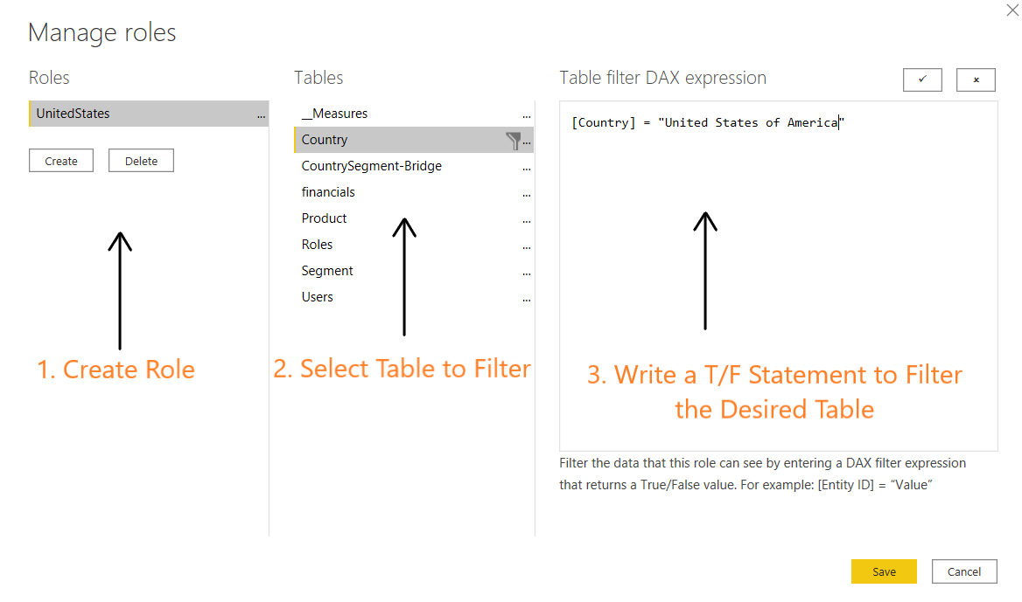
Defining Roles and Rules in Power BI Desktop
Create a new role, select the table which you want to get filtered based on the role, and then create a True/False statement to filter this table with.

Slide 14
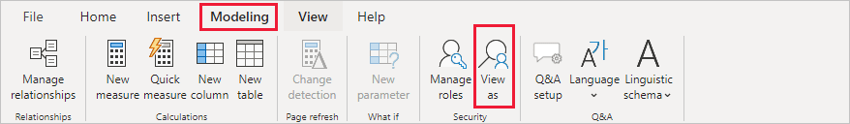
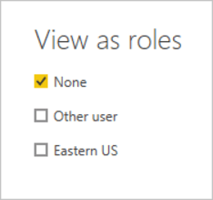
Defining Roles and Rules in Power BI Desktop
Now that the role has been created test the functionality using the ‘View as’ button.
Check the box next to the role you would like to test.
You are now impersonating the role (notice the yellow warning bar indicating the current role being applied).
Repeat these steps for every desired role.

Slide 15
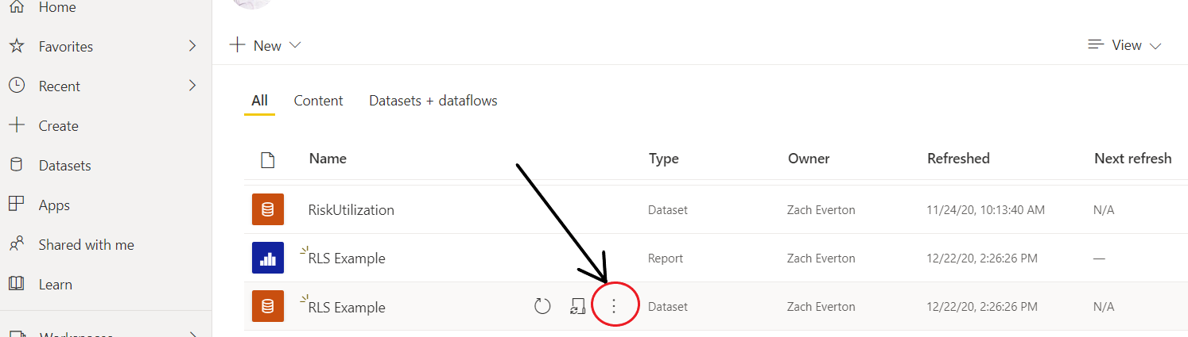
Defining Roles and Rules in Power BI Desktop
7. After you have uploaded this report to the Power BI portal, go to the Security settings for the data source to assign Users to the desired roles.

Slide 16
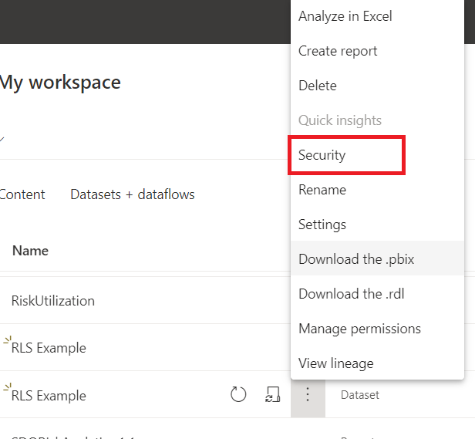
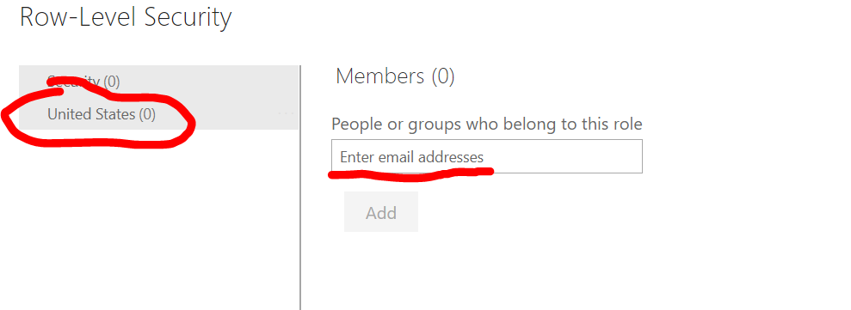
Defining Roles and Rules in Power BI Desktop

Slide 17
Dynamic RLS
For Dynamic RLS you will perform similar steps as above, however you will use a dimension table (dim_user) to identify which location(s) who are responsible for.
The benefit if using a dimension table is that it will always reflect the most current data and won’t require you to make manual security changes each time the data changes.
The dimension table will be linked to the fact tabe (fct_sales) with the dimension table filtering the fact table.

Slide 18
Dynamic RLS
With the Power BI report open, bring in the dimension table.
Create a relationship between the dimension and fact tables (with the dimension table filtering the fact table).
Select ‘Modeling’ → then ‘Manage Roles’
Select ‘Create’ → add a name to identify your new role (‘Users’).
Under ‘Tables’ → select the vertical ellipses (…) → select ‘Add filter’ and then choose the field from the table you want to filter by (‘user_email’)

Slide 19
Dynamic RLS
Add in logic for what you want to filter the field by (‘user_email = userprincipalname()’) → select the check mark (‘Verify DAX Expression’) → select save.
Validate: select ‘Modeling’ → select “View As’ → select the role you just set up → select ‘Ok’ → verify that the data is filtering as expected.
Save and publish the Power BI report to a Power BI Workspace.
Navigate to the Power BI Workspace.

Slide 20
Dynamic RLS
On the dataset (in Orange) → Select the vertical ellipses (…) (‘More Options’) → select “Security’
Add users to the role (‘Users’) you established → select ‘Save’.
Select the vertical ellipses (…) next to the security group (‘More options) → select ‘Test as role’ → ensure that the RLS is working as expected.

Slide 21
Example SalesdataRLS to follow.

